Slide 1
Here’s What's Ahead for Next Year
Tish Harris Caroline Rammacher
Rick Bradley Chuck Schwab

Slide 2

Allow us to introduce ourselves
And please let us know who you are and where you are from!

Slide 3
Have any of your students attended Student Team Programs? We would like to hear their feedback from you!
Our challenge for you:
As we describe each type of program, write down one student name who would enjoy or benefit from the program!

Slide 4
How do Student Programs expand core curriculum?
Increase independent living skills at our residential programs
Boost O&M skills
Enhance Social Interaction skills
Reinforce self-determination and advocacy
Raise awareness of the importance of recreation and leisure activities
Notes:
Rick and Caroline take turns

Slide 5
Who is eligible for Student Team Programs?
Ages 14-until 22nd birthday
Something for all interests and abilities!
Some more advanced programs have a reading and math suggested skill level
We can connect students quickly!
Notes:
Rick and Caroline

Slide 6
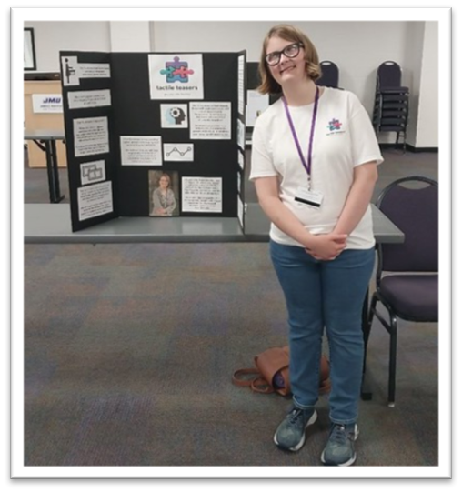
Note from a Parent
Last summer, we took our daughter to the JMU (James Madison University) campus to attend a week-long program, “Launching Point” for students to get a taste of the college experience. We dropped off a hesitant, nervous, unusually quiet young lady who did not know what to expect (and had not been away from home on her own since the significant vision loss more than a year ago). We returned to JMU, a week later, to find a confident, bright-eyed, happy, independent young lady. She gained skills (like realizing that she needed a cane to help with her mobility) and confidence (“I really can be away from home and be comfortable and independent”) during that week. The new-found friends (kindred spirits) and like-minded mentors and teachers inspired her with a renewed hope and energy. We are so grateful for DBVI!
Notes:
Tish

Slide 7
Student Programs fall into 3 categories
Residential
Cyber Space
Launching Point
at JMU- college Immersion
Virtual/Hybrid
Cyber Warriors,
Entrepreneurship,
Career Exploration in Nontraditional Careers, Adventures in O&M, Financial Realities
Family Engagement
Weekend programs: Spring into SUCCESS,
Careers in Action in October,
Career Exploration in Sports and Rec,
Single Day:
WWRC and
Career Discovery Day
Notes:
Tish explain the breakdown
Ask Rick and Caroline for feedback on their recommendations- if you have a new student, a tech student, a student who is creative, -IT IS NOT ONE SIZE FITS ALL
Rick- comfort level grows- build comfort level

Slide 8
Residential Programs build
Independent Living skills
Advocacy
Social Interaction Skills
CONFIDENCE
COMMUNITY
Notes:
Rick and Caroline

Slide 9
Video!

Slide 10
Cyber Space
Cyber safety and basics, HTML, firewalls and lots of techie stuff!
Working in teams in the classroom
Confidence and communications builders at night!
Comedy Improv
Blind Soccer Nation
Bowling
Super Soaker
Notes:
Tish

Slide 11
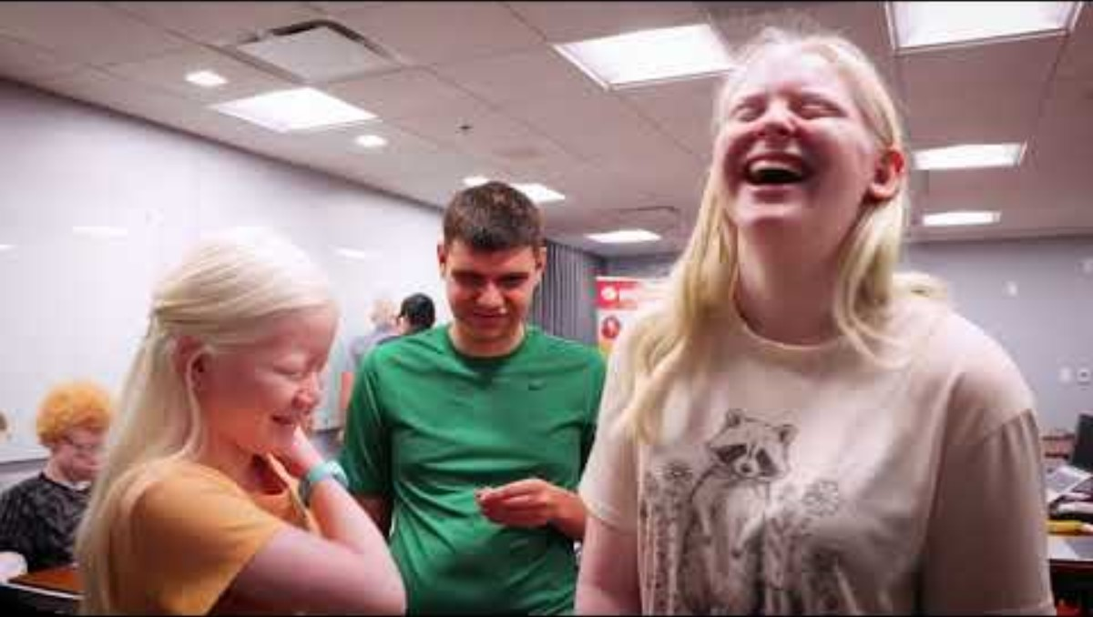
Video created by Palo Alto Networks

Slide 12
Launching Point
Any of your students thinking about college?
College immersion program where students:
Live in a freshman dorm and use the dining hall
Learn how to create the best admissions essay
Learn about requesting accommodations
Meet professors from all over the campus
Visit a community college to learn possibilities
Learn to use the transit system
Experience rec center and learn about clubs
Experience student life! Make friends and have fun!
Notes:
Tish start and do the list,
Ask Rick about presenting every year- his experience
Caroline- her experience

Slide 13
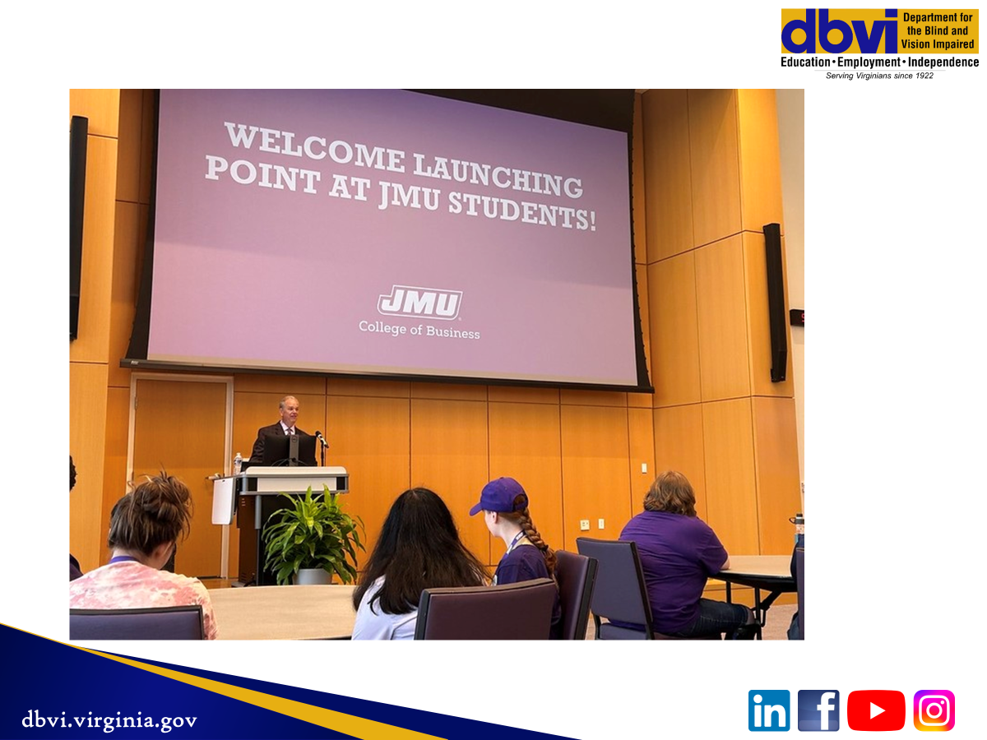

Slide 14
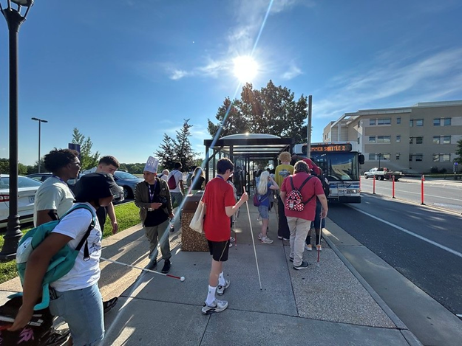
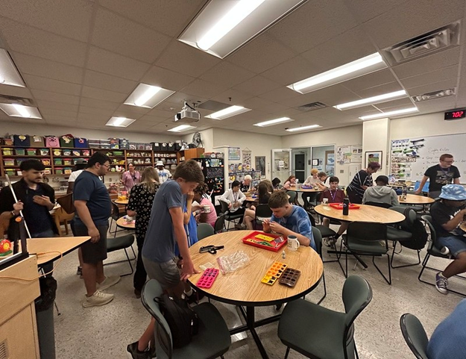
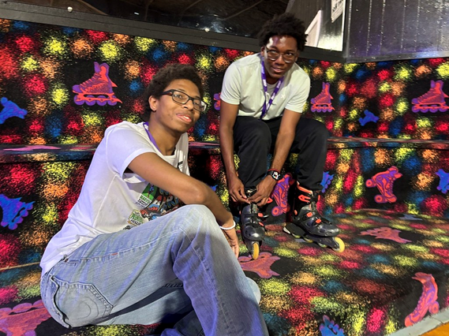
Living in a freshman dorm, learning the transit system, eating at D-Hall, experiencing a freshman first class at ISAT, meeting admissions and professors, and having fun

Slide 15
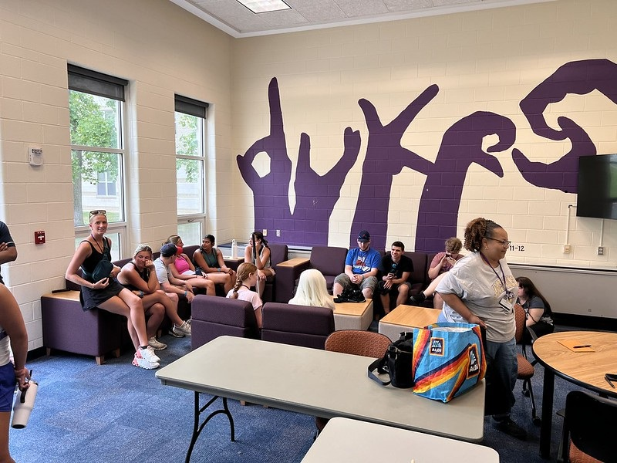

Slide 16
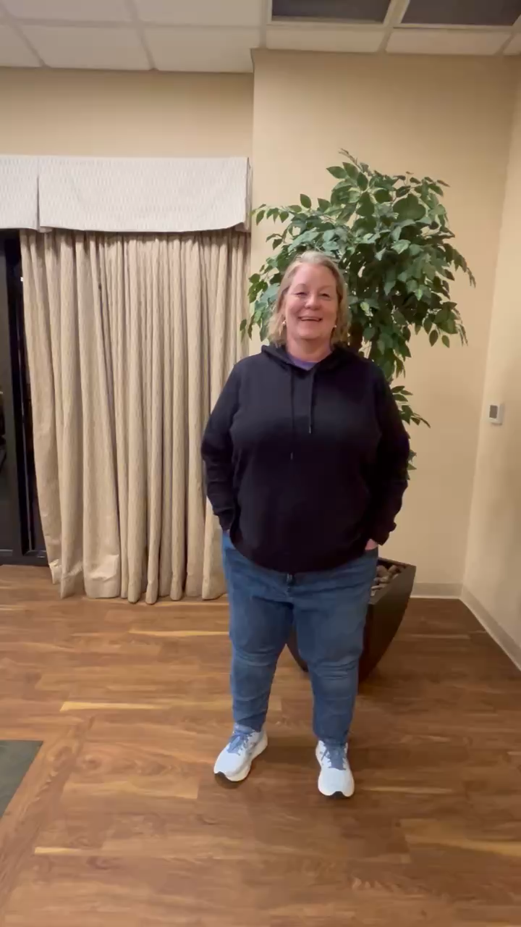
Kerry Foster Parent of DBVI Student

Slide 17
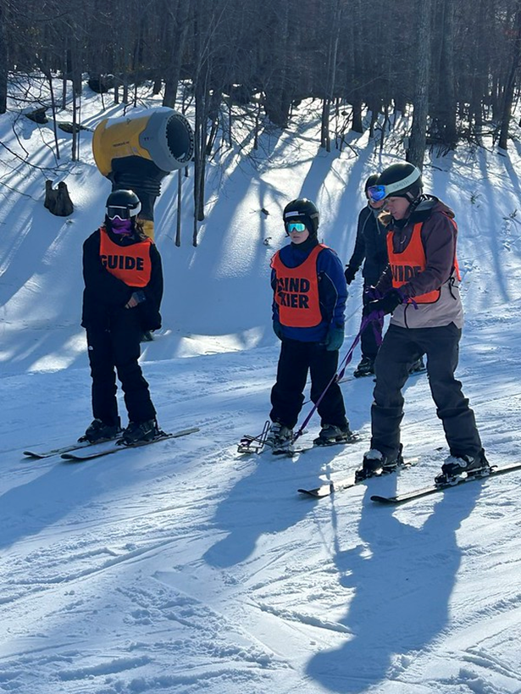
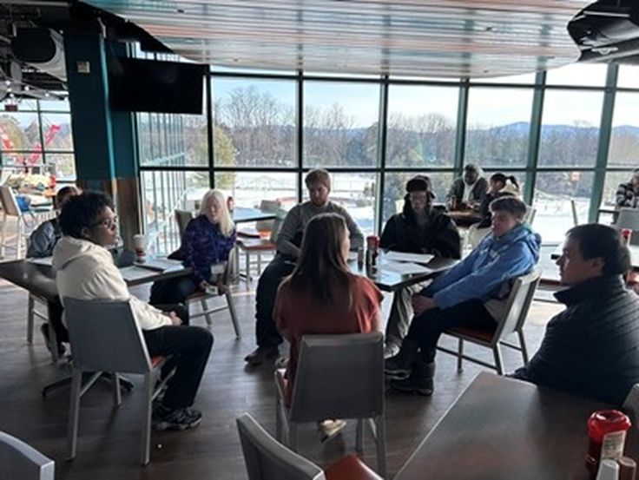
CAREER EXPLORATION INTO SPORTS AND RECREATION AT MASSANUTTEN RESORT-Jan 2026

Slide 18
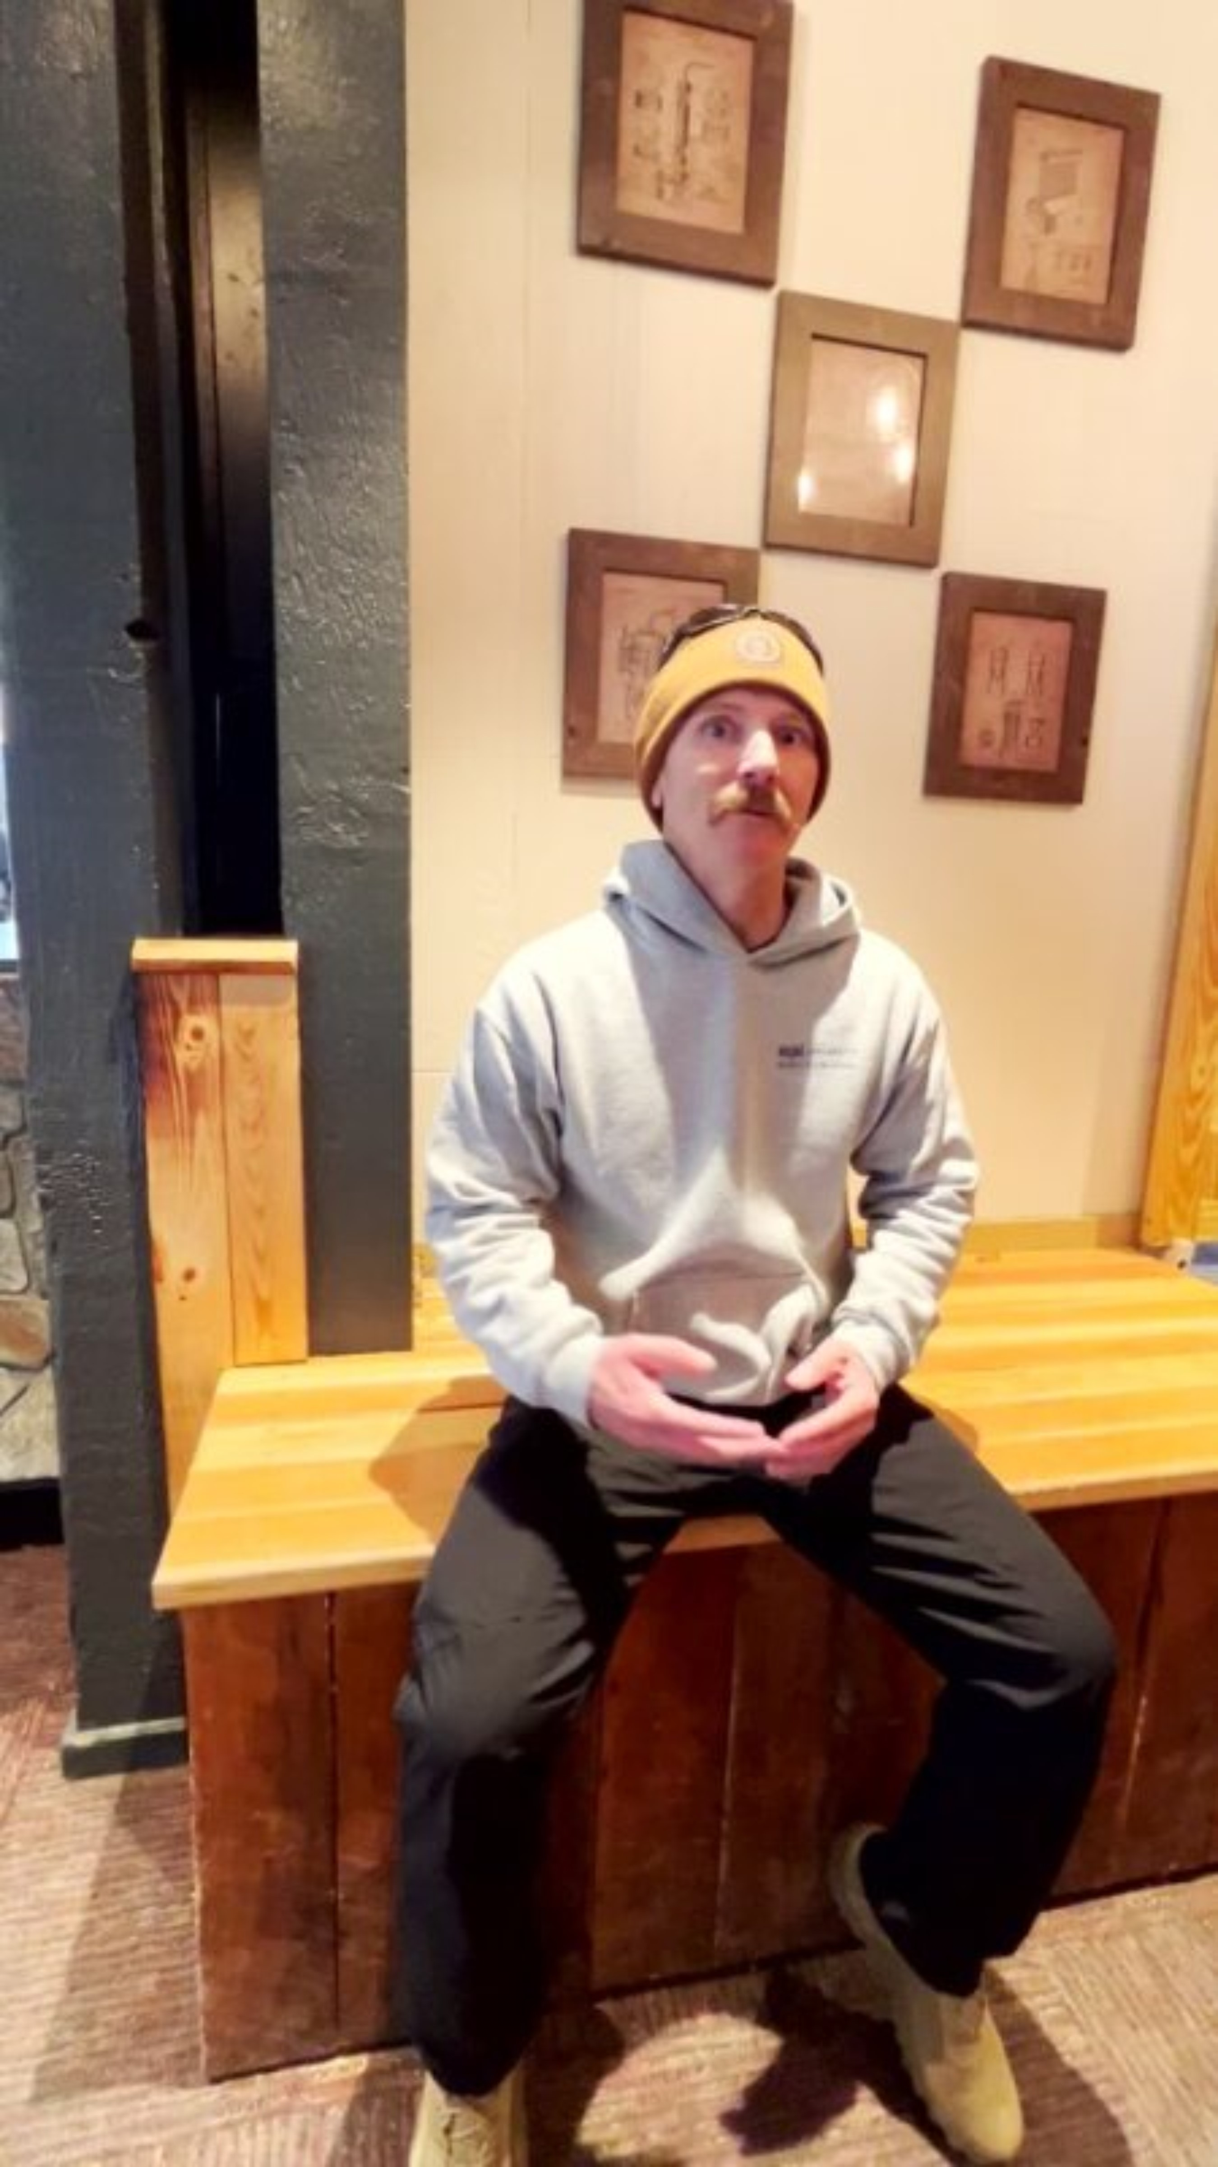
Parent of a student new to DBVI programs

Slide 19
Family Programs
Great for beginning or returning students
Parent or guardian comes with the student
DBVI pays for room, food and activities for student and parent(s)
Held once in Spring and once in Fall
Adaptive skiing held once per year
Parents get information as well as students!
All levels and all interests!
Sunday is always Fun Day- a day of trying and learning new things and stepping outside of your comfort zone for students
Notes:
Rick, Caroline and Tish take turns- answer questions, give support for these as first time programs

Slide 20
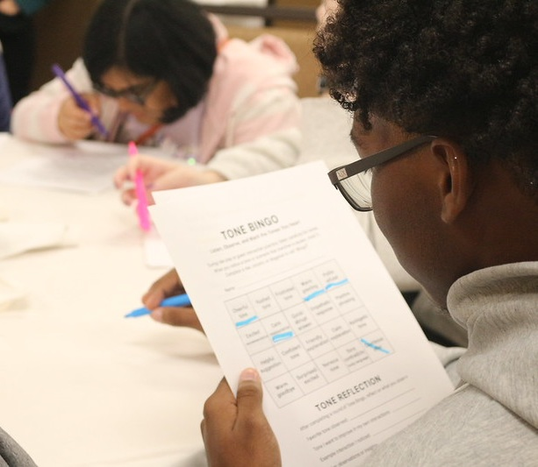
Careers in Action
Hands on career exploration and putting learning into action!

Slide 21
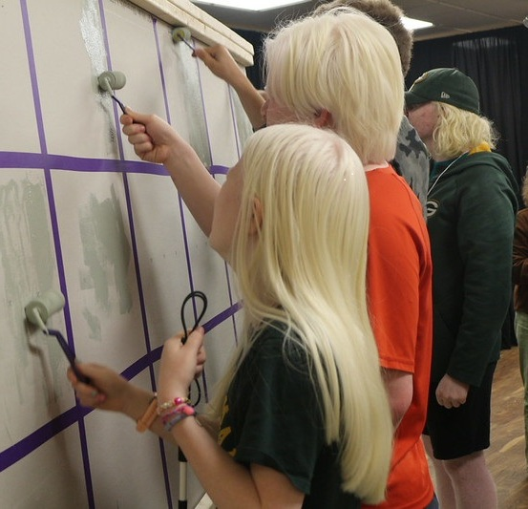
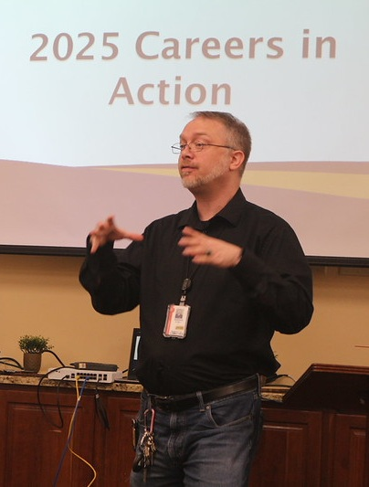
Painting fun with Maintenance
Cyber and IT presentation

Slide 22
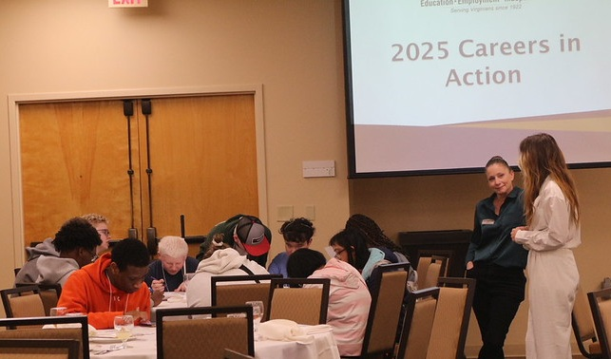
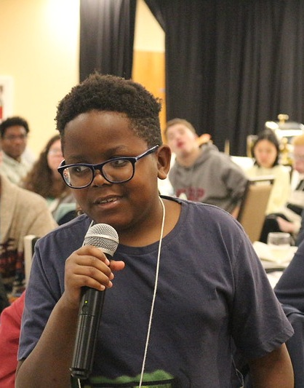
Customer Service presentation from Front Desk and Concierge
Sharing 30 day and 6-month goals!

Slide 23
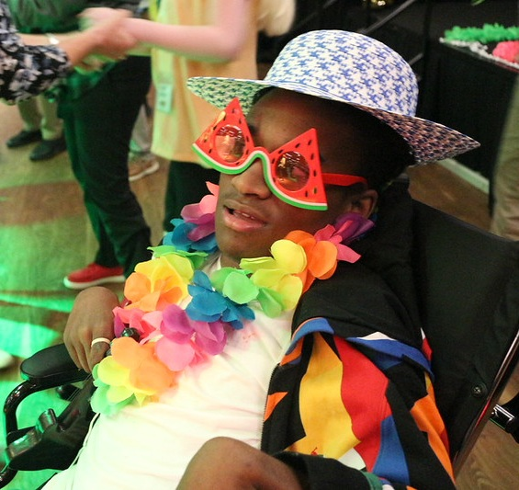
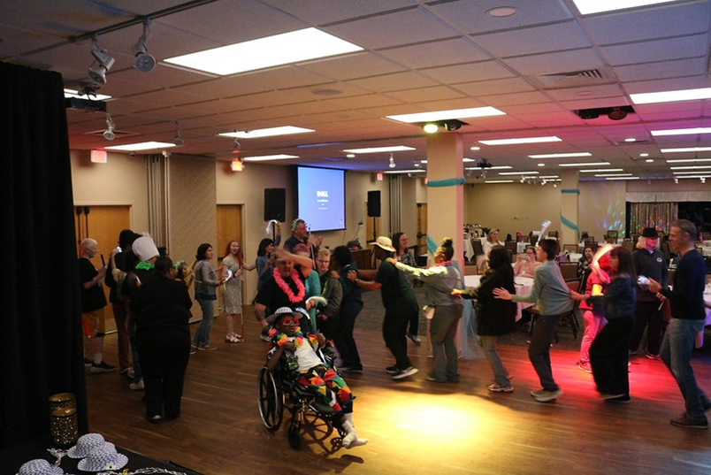
Fun for all! Even Parents got in on the Dance Party!

Slide 24
In 2026- Spring into SUCCESS in Portsmouth March 20-22 and Careers in Action in Hampton in October
In 2027 – we plan to move across to the other areas of the state!
Notes:
Tish

Slide 25
Virtual and Hybrid
Programs vary to provide diverse offerings
Career Exploration
Can join from anywhere with internet
Loaner laptops available
Hybrid begins online and culminates with in person
Notes:
Caroline

Slide 26
DBVI: Online Options
Resiliency- New Year New You!
Town Hall
Inclusive Higher Education Programs for SWD
Smart Money Moves for Financial Literacy
Career Exploration into Arts and Creative Careers
Jump Into Summer Program Review
Cyber Warriors
Tiered IT Cohort to earn industry recognized credentials
VCU Mentoring Program
Give Thanks Social Event

Slide 27



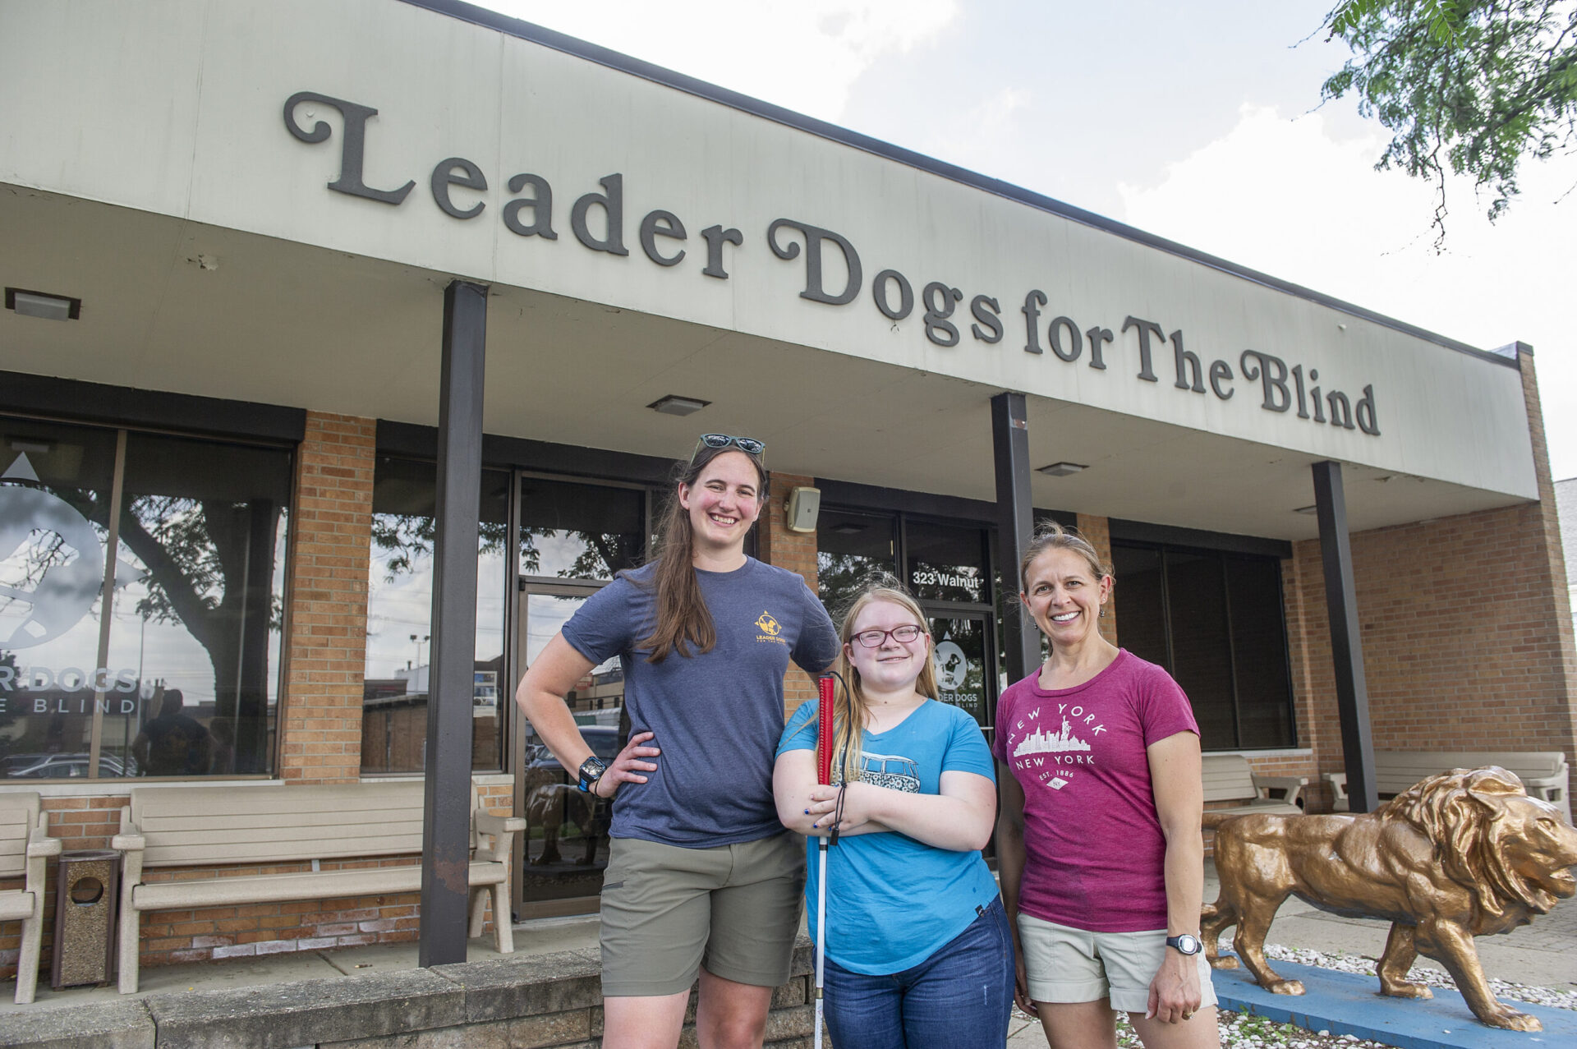
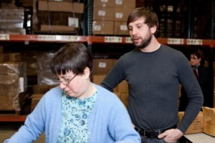
Smart Money Moves
Alternative Secondary Education Programs
Adventures in Orientation and Mobility
Supported Employment

Slide 28

Cyber Warriors
Began during Covid and still going strong
Skepticism at the beginning!
In 2025 95 programs taken! 7 programs
In 2024 97 programs taken! 6 programs
In 2026- ???? -5 programs- 98 applications and it is only March!
Notes:
Tish

Slide 29
Cyber Warriors
We send equipment to student’s house in advance
Student gets on Zoom to put it together , code it or learn to use it
Student keeps the equipment for continued learning
Supports include breakout rooms and recorded lectures
Some are second year programs
GREAT CAREER EXPLORATION
If student needs some help with small parts, that is fine
Notes:
Tish
Rick- good for students to explore even if they don’t have a tech goal – you don’t know what you don’t know

Slide 30
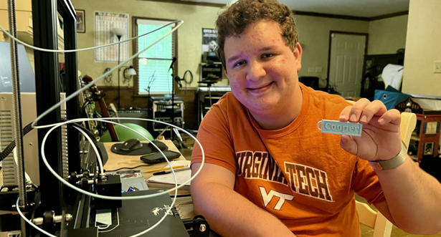
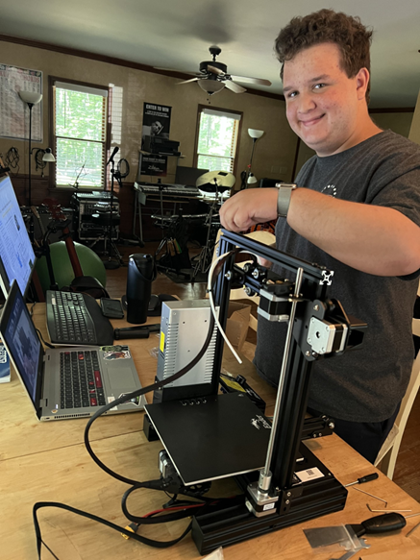
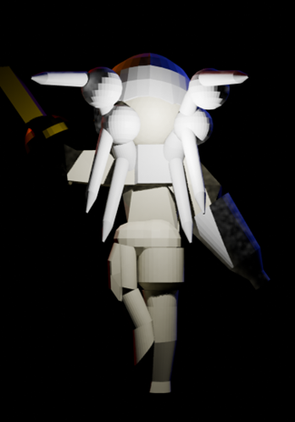
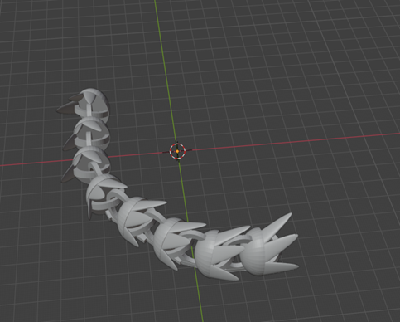
Cyber Warriors in action
3-D print photos! We now offer both beginner and advanced 3-D Print programs

Slide 31
CW Summer 2026:
AI Unleashed
Advanced 3D Printing **
Introduction 3D Printing
Build Your Own Gaming PC **
Ethical Hacker
** Advanced Programs – great for returners! These are second summer Programs
Notes:
Caroline

Slide 32
Always something new!
This year:
Career Exploration into Non-traditional careers
Already completed or in Progress
Sound Foundations
Financial Realities
Adventures in O&M
Supported Employment
Alternatives for Secondary Education Programs
Notes:
Caroline will cover

Slide 33
Hybrids!
EDGE- Entrepreneurship for Gainful Employment
Students learn virtually THEN
Participate in a Makers Market at JMU
Students create product or service pitch
Student the market for their idea
Come up with a logo
Come up with a pitch
Make it happen!
Notes:
Tish will cover

Slide 34
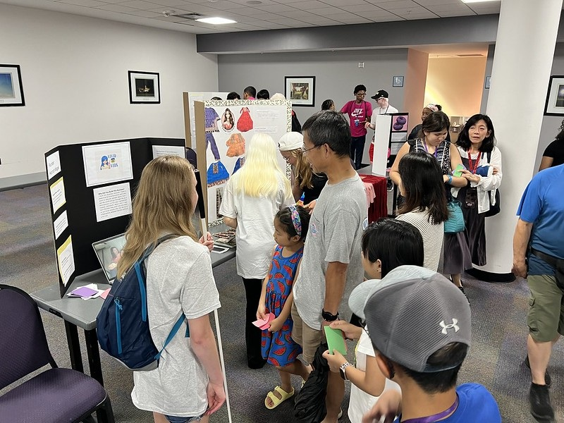
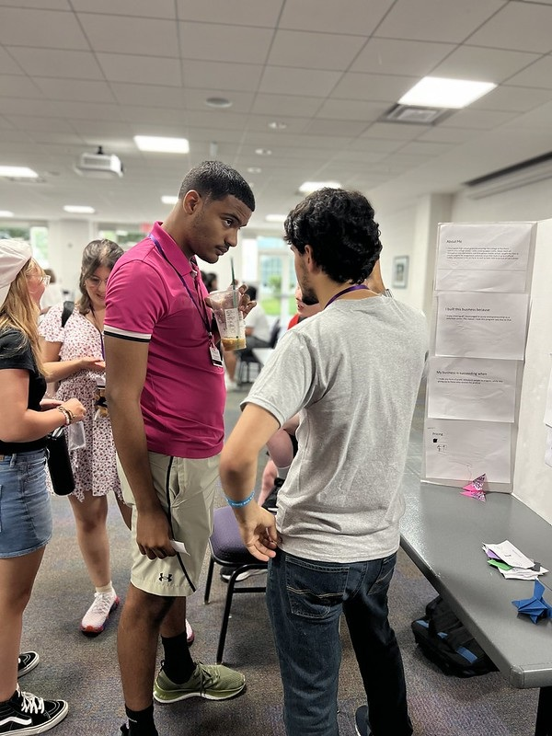
EDGE- Entrepreneurship for Gainful Employment
Students participated in online activities to determine a business concept, identify the markets, develop the product or service, develop delivery options, create a logo and online presence. Makers Market in person was the culmination.

Slide 35

ALSO NEW AND EXCITING
In partnership with the Lions Clubs, we have a treat for your students of all ages:
What are Lions Clubs?
Where are Lions Clubs?
What is A Ball for All
Link to website: A Ball for All | Blind Football | Adopt a ball | Become our superhero
Notes:
Chuck starts

Slide 36

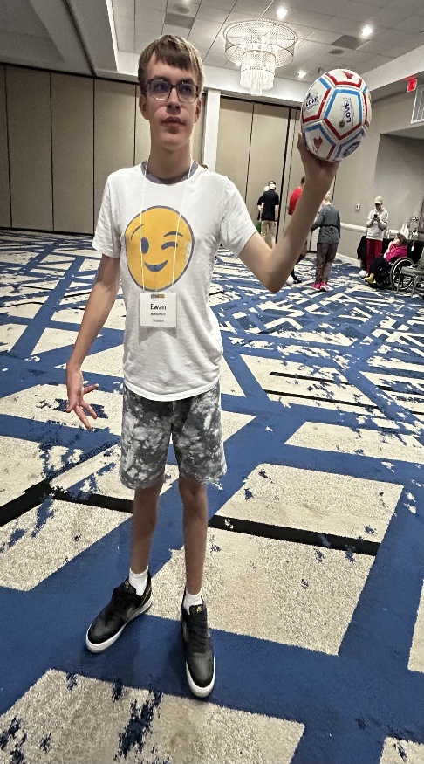
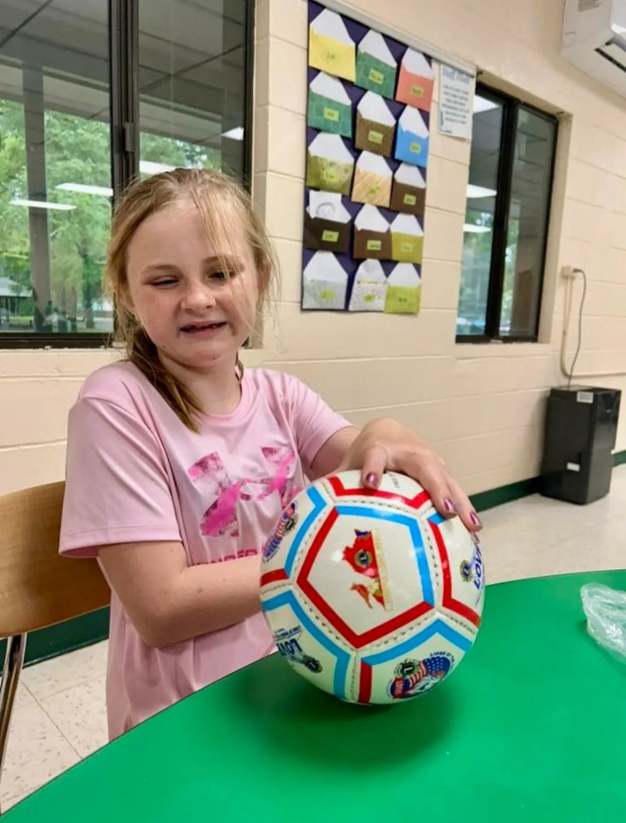

Photos of ball for all
Notes:
Chuck sending photos/videos to Tish
Taking video at Spring into Success

Slide 37
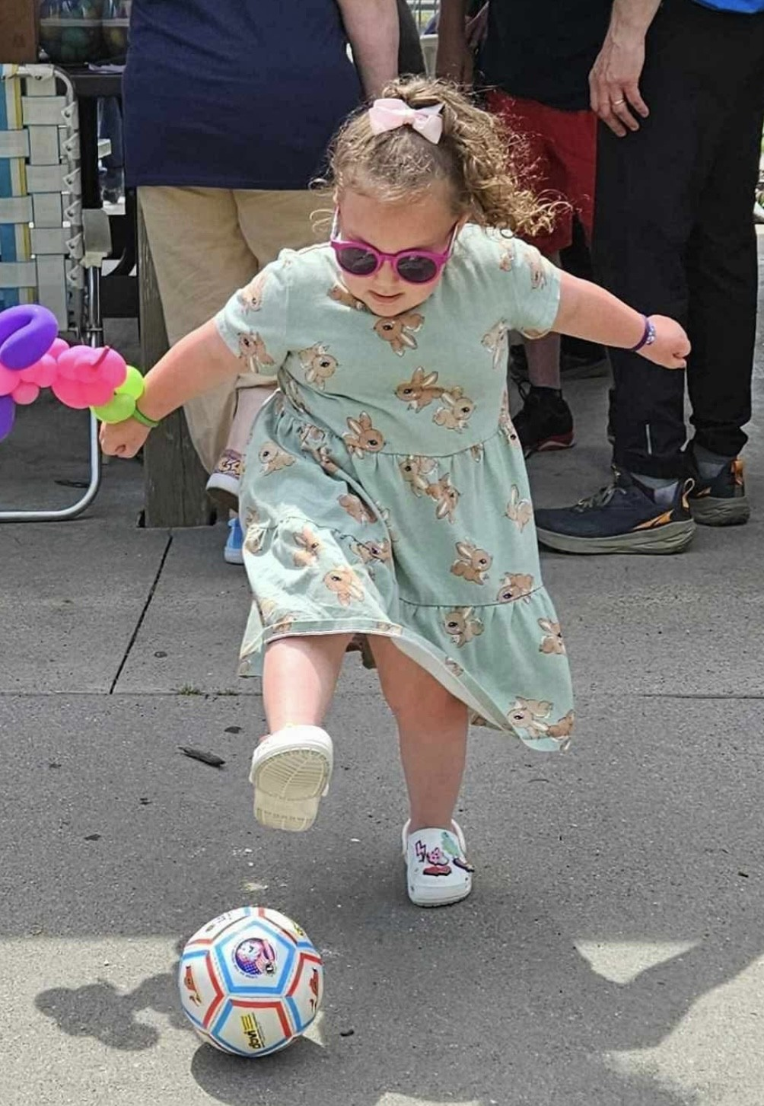
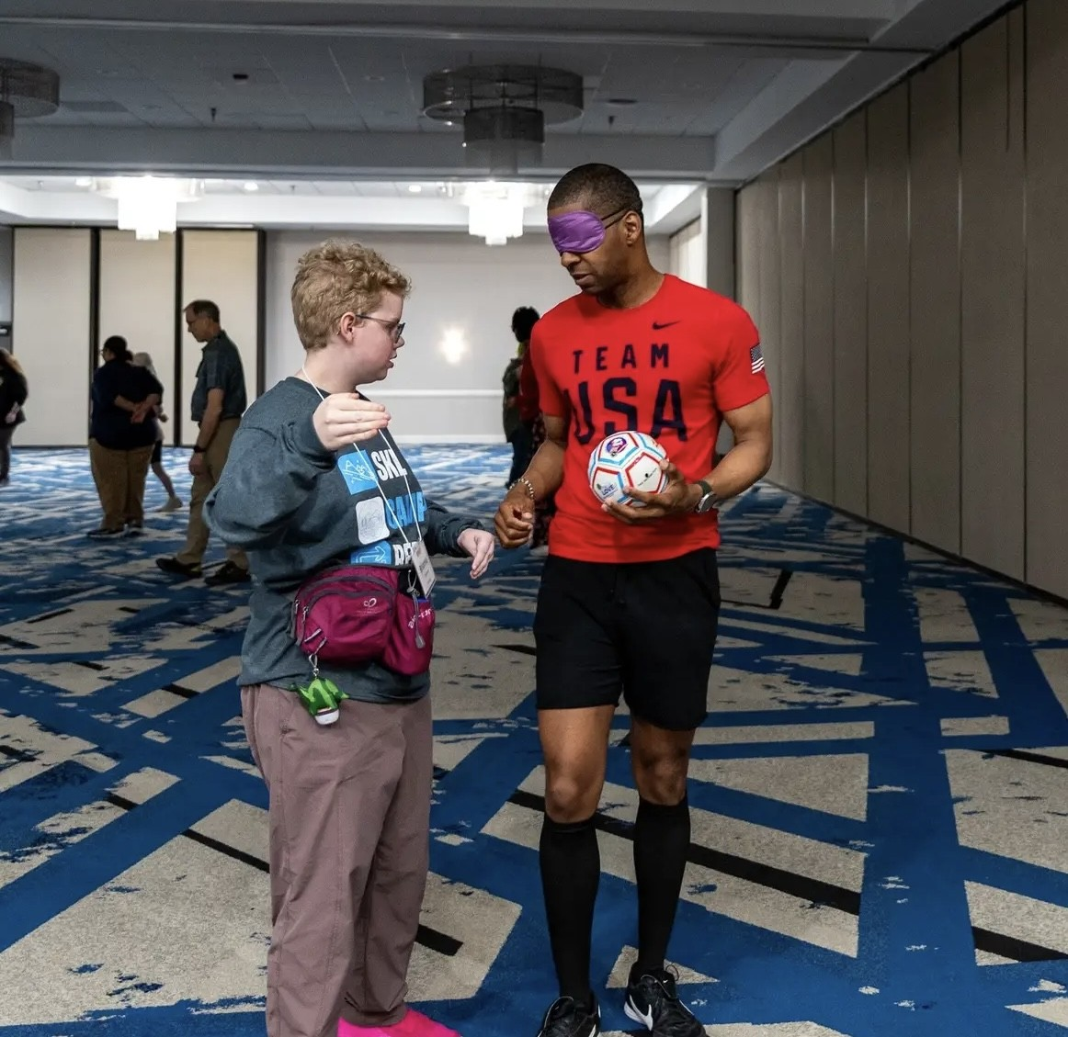

Slide 38

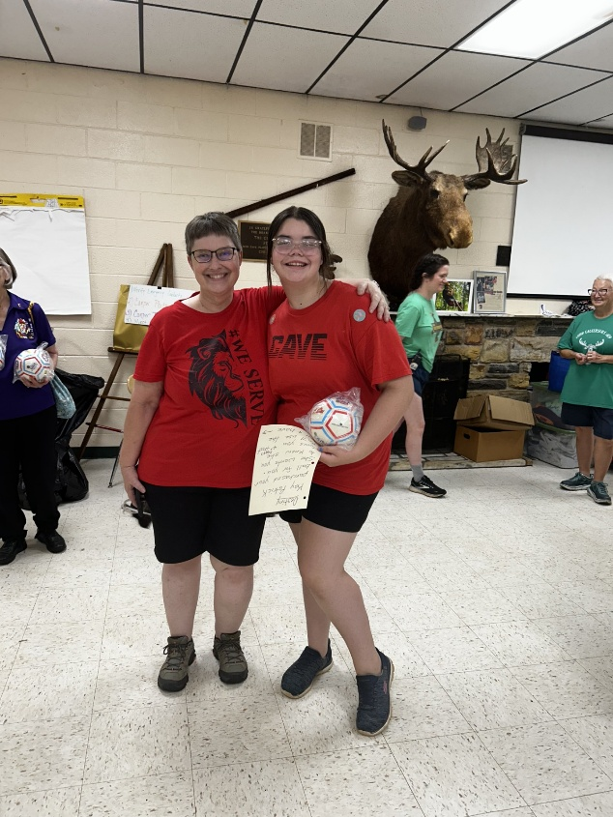

Slide 39
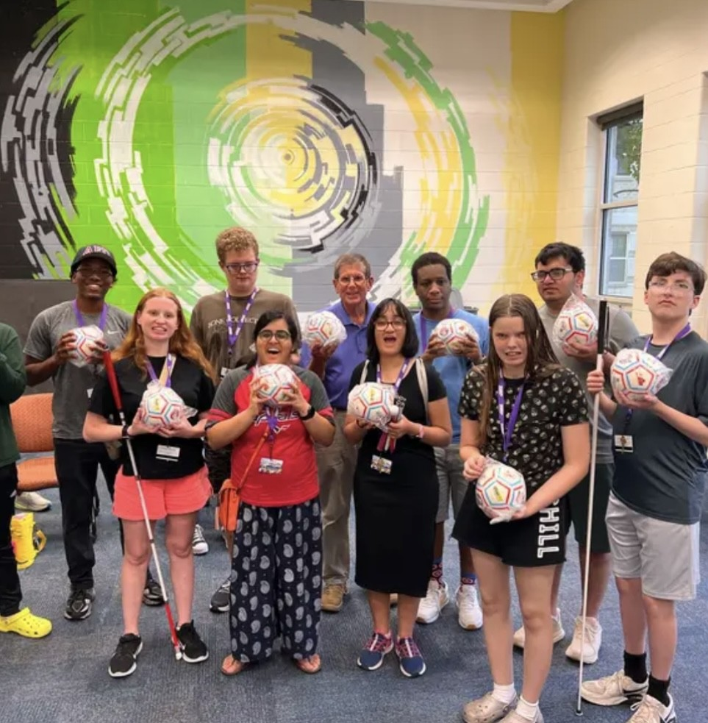

A Ball for All

Slide 40
Would you like to have soccer balls for your students or younger children?
Here is the process:
Identify students or children and make a list of first names, last initial and location- the location helps us match sponsors in local areas to those receiving balls
Reach out to Chuck at lionclschwab@netscape.net or at 540-476-1041
Balls are delivered or shipped
When you hand out the ball, please encourage the student or child (parent) to reach out with a thank you. Sponsor contact info is provided.
Notes:
Chuck will cover

Slide 41
Other Ways Lions may be able to help:
If you need help with any of these, contact Chuck to find out if there is a Lions Club in your area that can help:
Rides to appointments, camps or programs
Low vision equipment including glasses
Scholarship funding
Higher Education
Camps and Programs such as Super Summer Camp
Grant funding for special events like Beep Easter Egg hunt
The Opportunity to come visit a meeting
Information on Leo Clubs for youth
AND MORE!!!
Notes:
Chuck will cover

Slide 42
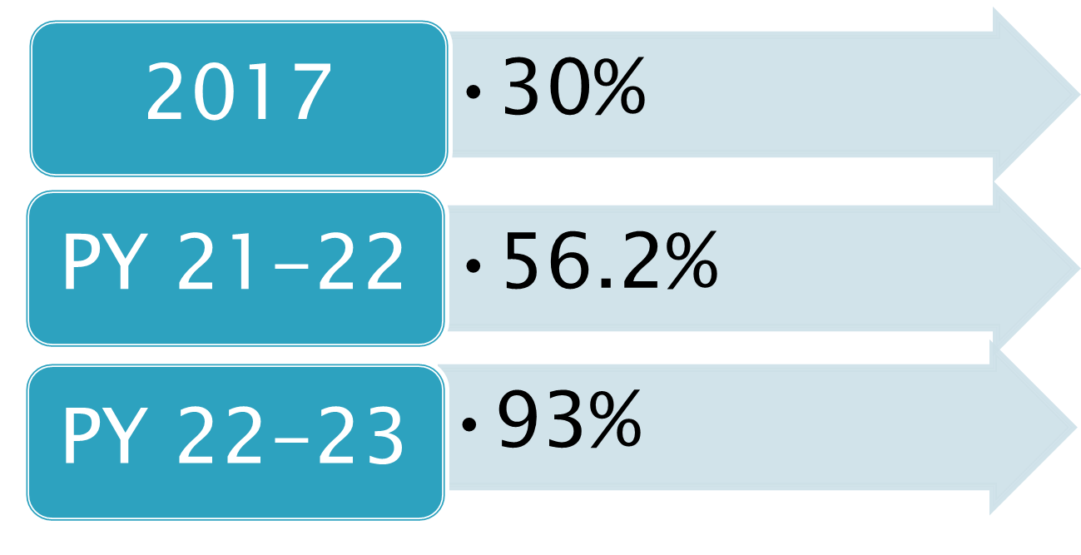
Let’s close with this! Are Student Team programs working? Measurable skills gains from NCSAB
PY 23-24
86% Still #1 in US
PY 24-25
86.4% -SD next at 72.9%
Notes:
Tish will cover numbers

Slide 43
Questions?
Chuck Schwab: lionclschwab@netscape.net or at 540-476-1041
Tish.Harris@DBVI.virginia.gov
Caroline.Rammacher@DBVI.virginia.gov
Rick.Bradley@DBVI.virginia.gov
Notes:
Put in emaisl

